Slide 1

How Successful were different countries in combating the covid-19 pandemic?
July 2020

Slide 2

Key Results
The research objective is to rank countries in terms of the efficiency of their response to the COVID-19 pandemic.
Methodology considers the following three dimensions: I. healthcare, i.e., results of healthcare systems in place and efforts to save lives; II. social, i.e., supporting incomes and maintaining jobs; III. economic, i.e., mitigating the economic damage.
Geographical coverage: the initial sample includes 48 countries. For some indicators, there are fewer countries, where the respective data is unavailable.
The calculation method includes obtaining an aggregate rating of countries on the basis of sub-indices for individual dimensions with equal weights (by 1/3) based on the geometric mean.
Limitation of the Analysis. For building the rating, a set of quantitative indicators has been generated, where not all country-specific features can be taken into account. National statistical data sets may be, at times, incomparable between themselves. Current results are based on the statistical data which is available today and may be reviewed in the future. Since the COVID-2019 pandemic is still ongoing, the final results (in particular, healthcare indicators) may differ from the present values.

Slide 3
Key Results
Russia ranks 7th (among 48 countries) in the overall COVID-19 Response Efficiency Rating.
for the healthcare dimension: #6 (77 points out of 100);
for the social dimension: #18 (72 points);
for the economic dimension: #12 (57 points).
Aggregate
Healthcare
Social
Economic
Source: estimates by HSE University

Slide 4
Rating Generation Method
Special Features in Creating the Rating
Varying (‘initial’) month for the epidemic’s start. For most countries, it is February 2020, while for some other countries – March 2020 or January 2020. Variations in the month of the epidemic’s start allow to more accurately consider the fact that the pandemic began in different times in different countries. At the same time, the use of the one and the same initial period does not allow to take these variations into account. The initial month refers to the month, when the number of confirmed coronavirus cases in a given country has passed 1,000.
Data from primary sources. We have utilized data received from national statistical agencies, as well as reliable international sources, thereby ensuring comparability.
Use of time series. We examined time series, rather than only individual indicator’s values at a given period of time. For rough series, the seasonal smoothing was done, if necessary.

Slide 5
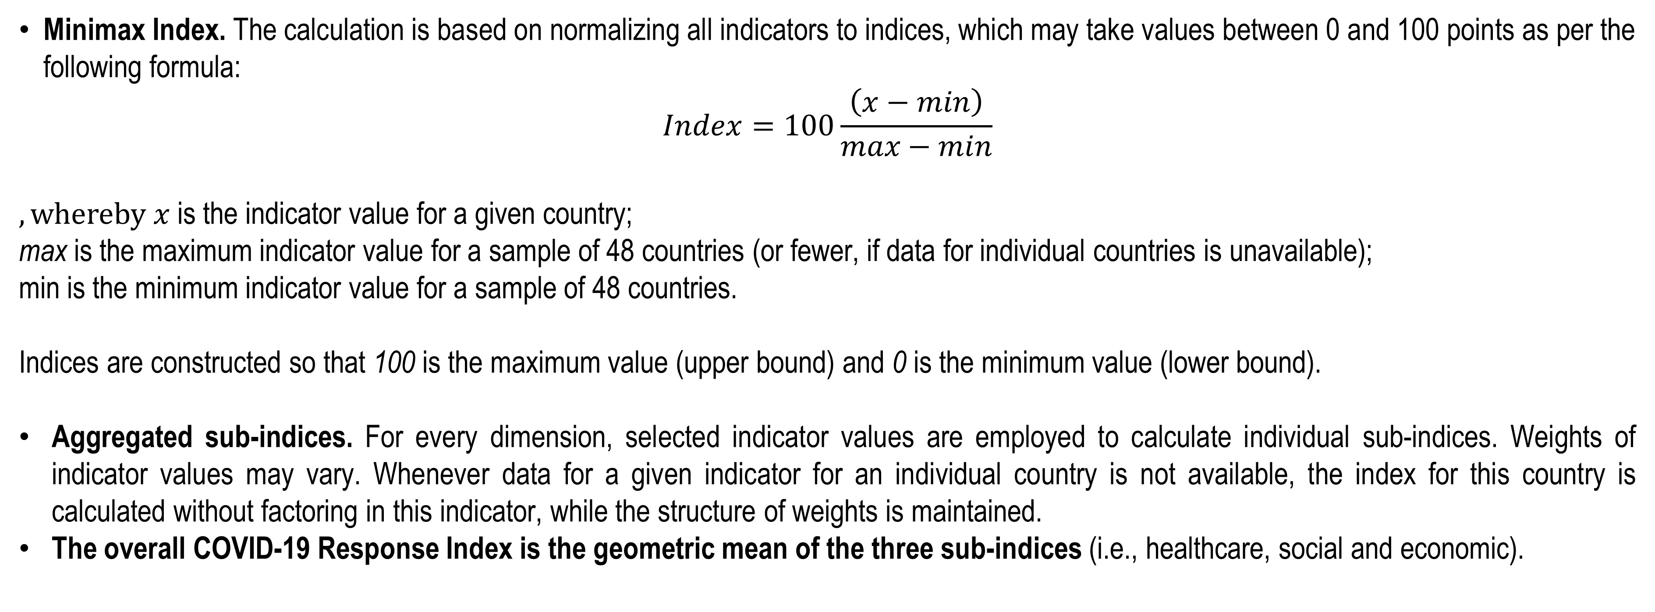
Special Features of Rating Calculation
Minimax Index. The calculation is based on normalizing all indicators to indices, which may take values between 0 and 100 points as per the following formula:
$$Index=100\frac{\left(x−min\right)}{max−min}$$
$, whereby x$ is the indicator value for a given country;
max is the maximum indicator value for a sample of 48 countries (or fewer, if data for individual countries is unavailable);
min is the minimum indicator value for a sample of 48 countries.
Indices are constructed so that 100 is the maximum value (upper bound) and 0 is the minimum value (lower bound).
Aggregated sub-indices. For every dimension, selected indicator values are employed to calculate individual sub-indices. Weights of indicator values may vary. Whenever data for a given indicator for an individual country is not available, the index for this country is calculated without factoring in this indicator, while the structure of weights is maintained.
The overall COVID-19 Response Index is the geometric mean of the three sub-indices (i.e., healthcare, social and economic).

Slide 6
Geographical Coverage for the Rating
For generating the country sampling, the following criteria have been formulated:
The scope of the epidemic spread (>5,000 confirmed cases as of mid-July 2020). Countries with fewer cases either are small economies with the small population, or, presumably, fail to track the coronavirus spread properly (mainly, African countries).
Population (over 10 million persons).
The size of the economy (with PPP being over $200 billion in 2019).
Neighbouring countries, which are frequently mentioned by Russia’s media but do not satisfy the specified criteria (i.e., Armenia, Belarus), have been included in the sampling. The final sampling for the analysis lists 48 countries. The total population of these countries comes to 6.35 billion people (82.5% of the world population).
1 | Australia | 25 | Malaysia
2 | Austria | 26 | Morocco
3 | Algeria | 27 | Mexico
4 | Argentina | 28 | Nigeria
5 | Armenia | 29 | Netherlands
6 | Bangladesh | 30 | Pakistan
7 | Belarus | 31 | Peru
8 | Belgium | 32 | Poland
9 | Brazil | 33 | Portugal
10 | Great Britain | 34 | Russia
11 | Ghana | 35 | Romania
12 | Germany | 36 | Saudi Arabia
13 | Egypt | 37 | USA
14 | Israel | 38 | Turkey
15 | India | 39 | Ukraine
16 | Indonesia | 40 | Philippines
17 | Iraq | 41 | France
18 | Iran | 42 | Czech Republic
19 | Spain | 43 | Chile
20 | Italy | 44 | Sweden
21 | Kazakhstan | 45 | Ecuador
22 | Canada | 46 | ЮАР
23 | China | 47 | South Korea
24 | Colombia | 48 | Japan
Note: countries included in the ranking are highlighted in blue.

Slide 7
I. Healthcare Rating
Composite Healthcare Rating
The leaders of the Healthcare Rating are Australia (86 points), China (78), South Korea (78), Japan (78) and the Czech Republic (78). Chile (21), Brazil (32), Peru (35) and Armenia (38) have the lowest scores. Russia placed 6th in the rating, scoring 77 points.
In the Healthcare Rating, 48 countries were ranked on the following five individual components:
(1) healthcare system capacity per 100,000 people;
(2) total COVID-19 tests per 100,000 people;
(3) total COVID-19 confirmed cases per 100,000 people;
(4) peak load (i.e., maximum number of new cases over 30 days (for two incubation periods) per 100,000 people);
(5) total COVID-19 confirmed deaths per 100,000 persons.
Heightened weight – 1/3 (33,3%) – is assigned to the peak load indicator as a relatively objective metric indicating the scope of the outbreak and the load on national health systems. The other four indicators have weights 1/6 (16,7%), respectively
The Rating is based on the data from WHO and other courses as on July 10, 2020.
Source: estimates by HSE University.

Slide 8
Healthcare Rating Calculation Formulas
Health System Capacity
Infection rate per 100,000 people
Total tests per 100,000 persons
Healthcare Rating
=
16,7%
+
16,7%
+
16,7%
+
‘peak load’*
Maximum new cases in 30 days per 100,000 persons
COVID-19 deaths**
per 100,000 persons
33,3%
+
16,7%
+
* the weight for the peak load indicator has been doubled owing to the fact that this indicator reflects the total incidence rate and deaths from COVID-19 in the future for those countries, which have not yet passed the peak of their epidemics, along with smoothing out differences in approaches to tallying deaths in various countries
** death toll data has been adjusted for the population structure, i.e., the share of citizens over 65 years of age has been taken into account
Health System Capacity
Number of physicians per 100,000 persons
Number of health personnel
Number of hospital beds per 100,000 persons
=
40%
+
30%
+
30%

Slide 9
Healthcare Rating Calculation Methodology
A number of methodological challenges arises when evaluating the rating in real time. Firstly, countries are at differing stages of the epidemics. Some countries have passed the peak of the first wave and are seeing the decline in infection rates, some others are experiencing the second-wave resurgence in cases, and others have not yet reached the peak in the first wave of the infection activity. Secondly, countries apply different policies in relation to testing: while some countries are implementing large-scale coronavirus testing, others have limited their testing to instances where it is deemed necessary. Thirdly, approaches to counting fatalities vary as well. Thus, some countries count death cases where COVID-19 was an accompanying rather than the main cause of death, while others tally only confirmed deaths caused directly by COVID-19. Fourthly, measuring the health system quality, i.e., medical workers’ preparedness and training, number of hospital beds, posed a challenge.
Assessing the final rating for the healthcare dimension is only possible after the end of the epidemic. In real time, our approach rests on the data on infection rates and the peak load on health systems. The countries selected for the sample, primarily, has had sufficient means for organizing testing for COVID-19 and time (>1,000 cases had been identified in these countries by the early third of April). For countries, whose peak in infections is yet ahead of them, we apply additional measures: the peak load for 30 days is calculated as a total for 15 days up until the latest dot and the latest value, multiplied by 15, on the assumption that the reached peak level will continue throughout a given incubation and treatment period (this is confirmed by the actual data from the sampled countries).
Doubling the peak load weight is necessary because this indicator reflects the final infection rate in the future and the projected death toll for the countries that have not yet reached the peak, which, in turn, allows to harmonize the rating of the countries seeing differing stages of the COVID-19 crisis.
The correlation between volume of the testing and total cases per 100,000 people for 48 countries is weak: the ration is merely 0,4. Therefore, infection rates and peak load indicator prove to be more reliable in comparison with death toll metrics for the purposes of the analysis.
Weak relation between testing and number of cases per 100,000 people
Source: estimates by HSE University

Slide 10
The ‘Peak Load’ Calculation
The ‘peak load’ period for a country that has passed the peak (Italy)
The ‘peak load’ period for a country that has not
passed the peak (India example)
The peak load indicator displays the maximum number of new cases in 30 days per 100,000 people.
For countries not having reached the peak, the measurement is based on the assumption that the registered maximum level of new cases will continue for 14 more days.

Slide 11
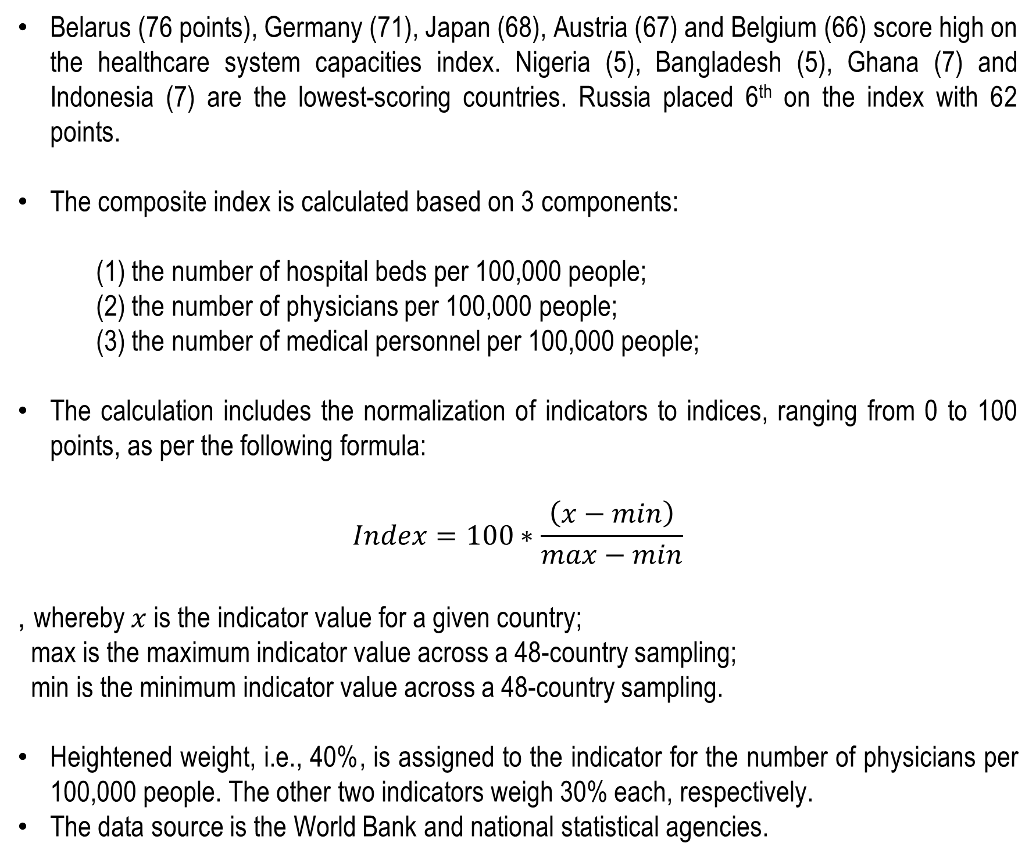
I.1 Healthcare System Capacities
Health System Capacity Index
Belarus (76 points), Germany (71), Japan (68), Austria (67) and Belgium (66) score high on the healthcare system capacities index. Nigeria (5), Bangladesh (5), Ghana (7) and Indonesia (7) are the lowest-scoring countries. Russia placed 6th on the index with 62 points.
The composite index is calculated based on 3 components:
(1) the number of hospital beds per 100,000 people;
(2) the number of physicians per 100,000 people;
(3) the number of medical personnel per 100,000 people;
The calculation includes the normalization of indicators to indices, ranging from 0 to 100 points, as per the following formula:
$$Index=100∗\frac{\left(x−min\right)}{max−min}$$
, whereby $x$ is the indicator value for a given country;
max is the maximum indicator value across a 48-country sampling;
min is the minimum indicator value across a 48-country sampling.
Heightened weight, i.e., 40%, is assigned to the indicator for the number of physicians per 100,000 people. The other two indicators weigh 30% each, respectively.
The data source is the World Bank and national statistical agencies.
Source: WHO, estimates by HSE University

Slide 12
I.1 (a) The Number of Physicians and Hospital Beds per 100,000 people
The Number of Physicians
The Number of Hospital Beds
Data on the number of physicians, medical personnel and hospital beds is released by national statistical agencies, as well as WHO and World Bank.
Japan and South Korea are top-ranked in the number of hospital beds per capita. Austria and Portugal are leaders in the number of physicians. Developing countries of Africa, Asia and South America possess low capacities to fight the pandemic.
Post-Soviet states have cut bank on health system capacities over the past decades, however, they still at the top of the index.
Vast health system capacities have been a crucial factory in why Germany’s response to the COVID-19 crisis has been more efficient than that adopted by other major European countries.
The presence of high capacities in a country’s health system imply that the government has potentially an opportunity to impose a somewhat lighter lockdown regime. Such countries as Germany, Japan, South Korea, have relied on relatively high capacities of their healthcare systems in their fighting the epidemic and have not introduced national quarantines.
The low average level of capacities in a country, by contrast, calls for a strategy of imposing a strict lockdown to localize virus outbreak: China exemplifies this approach, where healthcare capacities have considerably increased over the past years but still remain relatively low per capita.

Slide 13
I.2 ‘The Number of COVID-19 Tests Per 100,000 people’ Component
Testing Extent Index
Tests per 100,000 people
Large-scale testing is one of the possible options for containing the spread of the virus.
Our assessment based on the inter-country regressions shows the elasticity of the number of cases per 100,000 people with respect to the number of tests per 100,000 people comes to 0,66. This means that as the testing increases, the case count rises slower than the number of tests. Testing allows to identify the infected without symptoms and thus slow down the virus spread.
The following countries administer most tests: the UK, Russia and Israel.
Sources: WHO, OWID, estimates of HSE University

Slide 14
I.3 ‘The Number of COVID-19 Cases Per 100,000 People’ Component
Infection Rate Index
The number of Cases Per 100,000 people
The number of confirmed cases per 100,000 people reflects the spread of the epidemic at a given moment.
The leaders of the index are China, Japan, Nigeria and South Korea. The lowest scores are in Chile (by a wide margin), Armenia, the USA and Peru.
Sources: WHO, OWID, estimates of HSE University

Slide 15
I.4 ‘Peak Load’: Maximum Case Count in 30 Days (2 Incubation Periods)
The ‘Peak Load’ Index
‘Peak Load’ Per 100,000 People
The ‘peak load’ indicator, i.e., the maximum number of new cases within 30 days per 100,000 people, is factored in to account for the countries’ passing different stages of the epidemic and mitigate the affects of employing different approaches to tallying COVID-19 deaths. During 30 days, capacities for monitoring detected cases and consistent post-treatment check to make sure a recovered patient stays negative for COVID-19 are required.
The leaders (Chine, Nigeria, Japan, South Korea) and outsiders (Chile, Brazil, Armenia and the USA) for this index are the same as for the incidence rate index, however, the changes have occurred in the middle tier of the rating. In particular, restrictive measures imposed by the Russia’s government have allowed to flatten to peak in infection rate. That’s why in the peak load index Russia ranks higher than when overall coronavirus cases are compared.

Slide 16
I.5 The Number of Deaths from COVID-19 Per 100,000 People
The Mortality Index
The Number of Fatalities Per 100,000 People
The number of confirmed fatalities caused by COVID-19 per 100,000 people is an indicator dependent both from the epidemic stage in a given country and from the approach to tallying deaths.
Mortality also depends on the age structure in the population, as the mortality rate among those who are over 65 years of age is considerably higher than that among younger people.
Though it has flaws to it, this indicator is nevertheless informative. For instance, high mortality rate in Belgium cannot be quantitatively explained though the incidence rate, nor peak load, population structure or the absence of health system capacities. At the same time, high mortality rate, apparently, influenced both the strictness of restrictive measures imposed by the government and voluntary reduction in activities on the part of the Belgian citizens.
The lowest mortality rates are in China, Australia, Japan and South Korea; while Belgium (with a wide margin), the UK and Spain have highest death toll.

Slide 17
I.5 Mortality Adjustment for the Population Structure
The Share of Citizens Over 65 Years of Age
Adjustment Ratio
The adjustment for the population age structure was implemented through dividing the mortality indicator by the adjustment ratio. The latter was calculated Коэффициент рассчитывался, исходя из того, что летальность от заболевания COVID-19 в 10 раз выше в возрасте 65 лет и старше в сравнении с летальностью от вируса в возрасте младше 65 лет в среднем. Данные по доле населения старше 65 лет были собраны из баз данных Всемирного Банка и национальных статистических агентств.
Source: WHO, national statistical agencies, estimates by HSE University

Slide 18
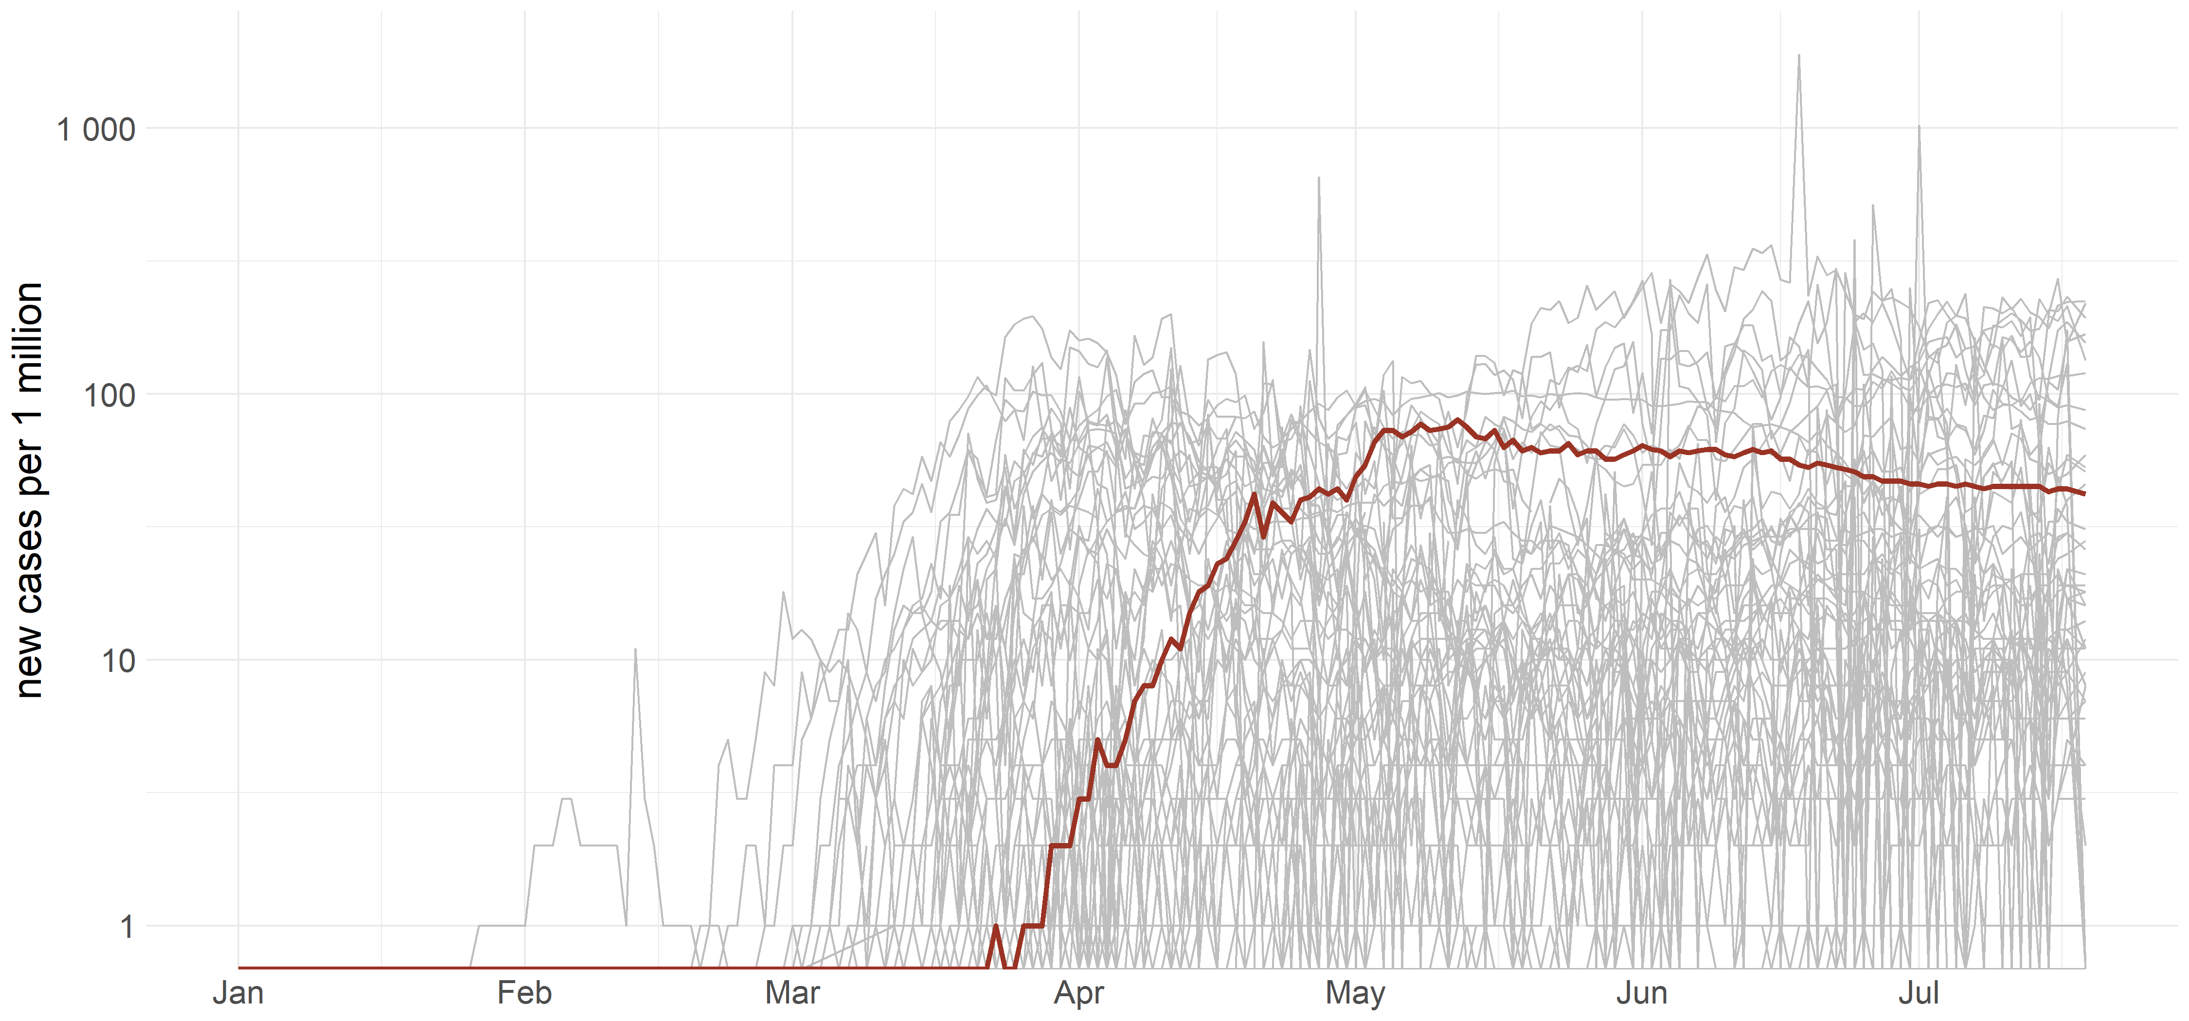
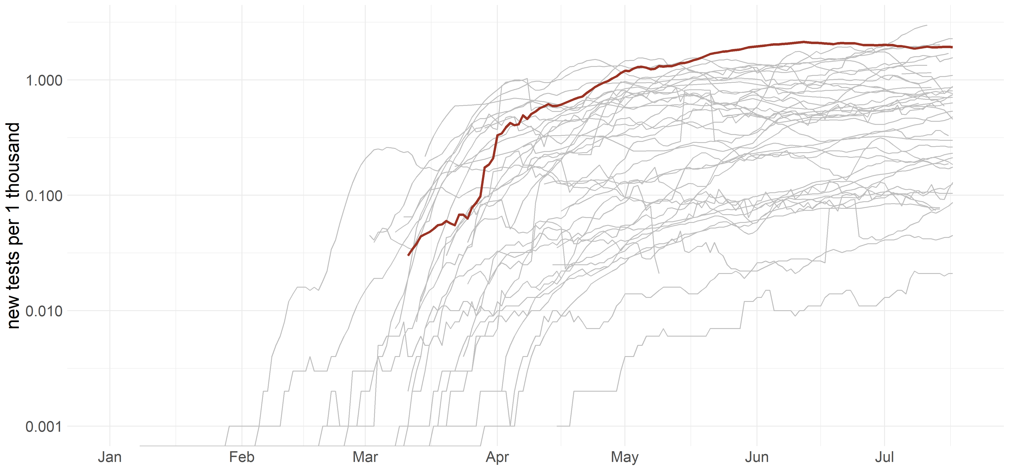
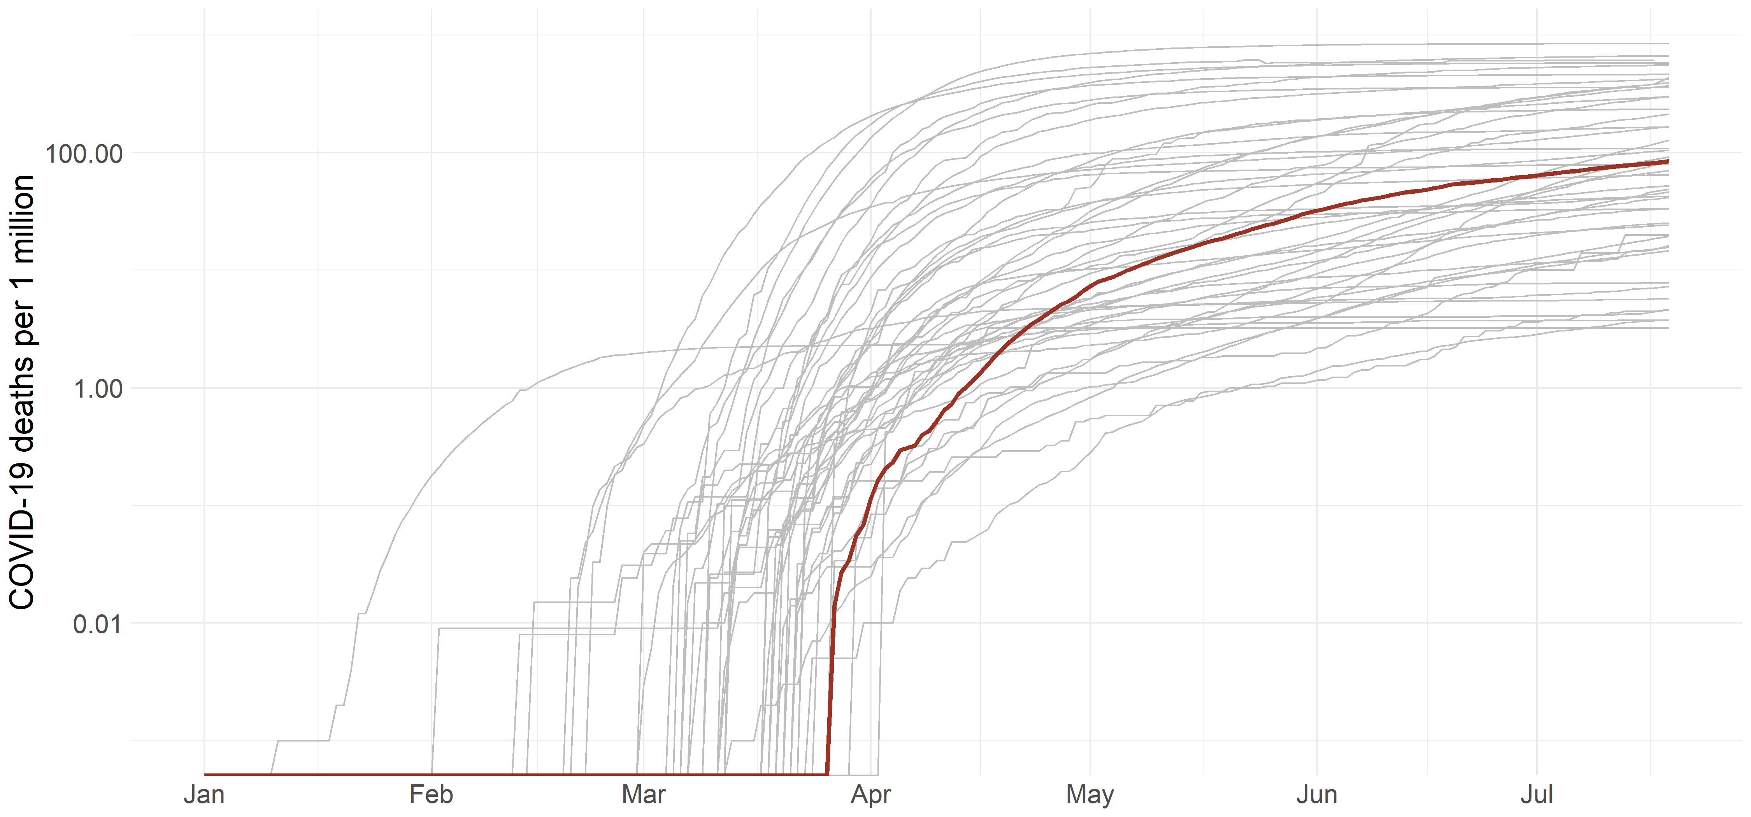
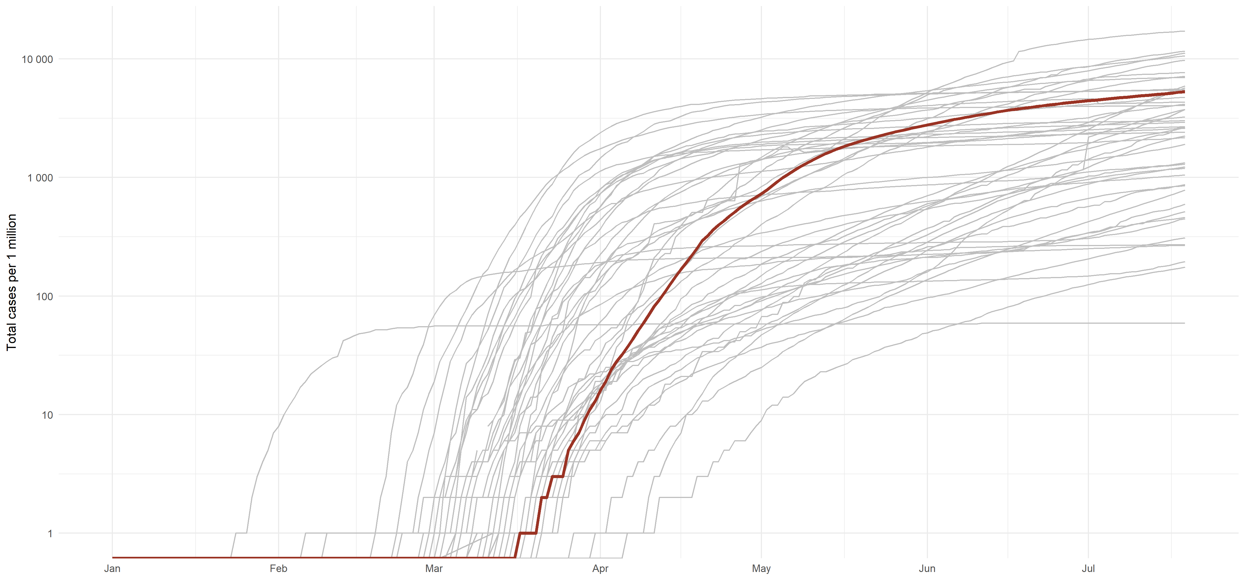
Healthcare Indicators: Source Data
The Number of New Identified COVID-19 Cases
The Number of COVID-19 Tests
The COVID-19-associated Death Toll
Total Confirmed COVID-19 Cases
Source: OWID, John Hopkins University, WHO. Note: Russia’s indicators are highlighted red. All Y-axis are log-scales.

Slide 19
II. Social Rating
Composite Social Rating
The social rating leaders are: Germany (91 points), Sweden (91 points), Belgium (86 and Australia (86 points). The outsiders in this list are: Morocco (10 points), Iraq (18 points) and Peru (26 points). Russia placed 18th with 75 points.
The composite rating for economy is calculated for 48 countries, relying on 3 separate components:
(1) changes in employment shows how effective the state’s and business sector’s efforts were to stabilize the job market;
(2) changes in retail sales shows changes in consumer behaviour during the pandemic and indirectly indicates changes in incomes;
(3) сhanges in prices for medication shows affordability of pharmaceutical products;
(4) stability of the educational system is an aggregate figure, indicating the adaptation of national systems of schooling and higher education during the pandemic period;
Heightened weight – 50% – is assigned to the employment indicator, as the situation on the job market has the biggest impact on the social situation.
The retail sales indicator and that for the education system have a weight of 20% each; medication prices – 10%. Changes in employment and retail sales are estimated excluding seasonal factors.
If the data for a particular indicator relating to a given country is not available, the indicators for this country shall be ‘re-weighted’, with their relative structure maintained.
Data sources for each indicator are provided on the slides for each respective indicator.
Source: estimates by HSE University

Slide 20
II.1 Decrease in Employment
Changes in Employment in Different Countries
Employment Change Rating
According to the International Labour Organization, during the second quarter of 2020, over 400 million people around the world lost their jobs because of the quarantine and economic recession thereafter, caused by the pandemic. Should the situation continue to worsen, the total number of the unemployed could increase by another 300 million persons.
Since the start of the pandemic, the number of the employed has reduced by 7.9 million people in Brazil (down 8%) while over 21 million workers lost their jobs in the USA (down 13%) . EU countries used paid shutdown plans, subsidized by the state. However, many large companies have already announced plans to make a significant number of their staffs redundant (the rating for changes in employment was drawn up with consideration of announced layoff plans).
Russia, owing to relief measures taken by the state, has been able to avoid significant drop in employment – in March-May 2020, less than 1.1 million jobs were lost (down 2%). In terms of effectiveness of the measures to support employed workers, Russia has placed 6th in the world, just behind Poland and several countries in Western Europe.
Source: national statistical agencies, Eikon, estimates by HSE University.

Slide 21
II.2 Changes in Consumption
Retail Sales
Consumption Change Rating
Quarantine restrictions, a decrease in income and rising unemployment were a great shock to household consumption in all countries. In the GDP structure of many countries, household consumption is a core feature, and thus the changes in consumption has a major impact on GDP dynamics.
For a proxy indicator for changes in consumption, we use monthly data on retail sales (GDP data is released with a considerable delay). We assess the changes in retail sales 3 months after the initial month (for seasonally adjusted data).
Source of data is national statistics agencies, Eikon. The current sample includes 26 counties (for certain countries data is not available)
The leaders in supporting consumption are Australia (100 points), Sweden (99), Germany (88) and the Czech Republic (88). Outsiders are Kazakhstan (0), Argentina (4), Peru (10).
Russia placed 21st (26 points) In May 2020 (t+3), retail sales in Russia were at 79% against the initial month (February 2020).
Source: national statistical agencies, Eikon, estimates by HSE University

Slide 22
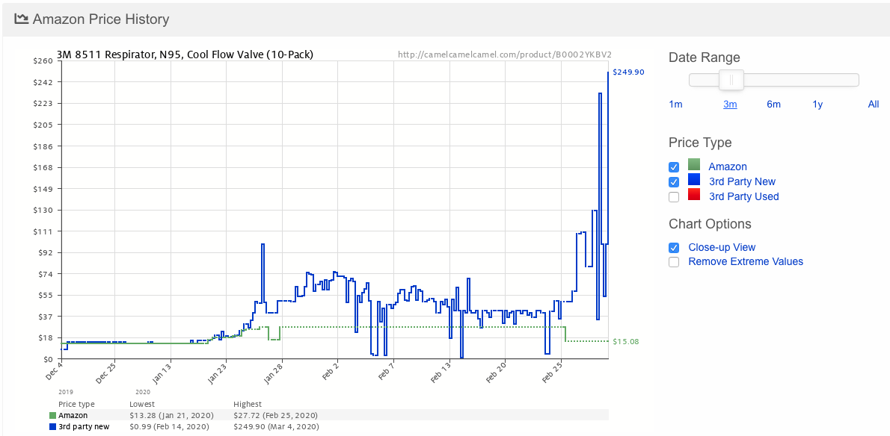
II.3 Prices for Medicines
Prices for Medical Masks, Amazon, Dec.19-Feb.20
Rating for Price Changes for Medicinal Products
The coronavirus pandemic has resulted in speculative demand for personal protective equipment (PPE), and hence the surge of prices for such equipment. In February-April 2020, prices for medical masks went up 5-10 times; for sanitizers and disinfectants – by 4-7 times. In May-June 2020, PPE costs, owing to rising supply, started to decrease, but nevertheless remain 1.5-2 times above their pre-crisis costs.
Overall, the cost of pharmaceutical goods and medicinal items, sold through pharmacies, over the entire period of the pandemic, remained stable in most countries. The biggest price hikes were noted in Kazakhstan (up 10.2% since the start of the crisis), Turkey (up 8%), and the Netherlands (up 6.5%). In Russia, the cost of medications in March-May 2020 went up by 4.2%
For this indicator, Russia ranked 42nd with 46 points. The leaders (the minimal price growth) on the ranking are Brazil (down 0.8%), Israel, the USA and western European countries.
Source: national statistical agencies, Yahoo, estimates by HSE University

Slide 23
II.4 Stability of Educational Systems
In terms of education, all countries have been dealing with the task to maintain the maximum involvement of school students and university learners in the educational process. To this end, actual types of engaging leaners in educational processes have been used as indicators (with respect to secondary professional training, this data has yet to be divulged), along with options for distance learning in national educational systems, finishing the academic year on time, and the provision of examinations. A key measure in ensuring access to education in certain countries has been efforts to provide work placement for students who have lost their jobs.
The indicator for each country has been calculated as the total points for the following aspects regarding the educational system (with subsequent conversion on a 100-point scale):
With respect to general education:
Formats for organizing distance learning for school students and university learners (synchronous/asynchronous use of distance learning technologies/use of television programmes and radio);
Options for providing content and technological support under national curricula (for all academic disciplines/for some disciplines);
Completion of academic year (maintaining traditional times for the close of the academic year/early close of the year);
Organization of school graduates’ final testing (maintaining current norms in final testing/correction of these norms/ cancelation of final tests).
With respect to higher education:
Formats for organizing distance learning for students (with the use of asynchronous learning/LMS university systems/LMS and online platforms)
Measures of national governments and universities to support students’ employment options during the pandemic.
In terms of stability of its educational system, Russia ranks 5-14th with 75 points. The leaders for this indicator are: Austria, Germany, Israel and Canada (88 points).
Stability Rating for Educational Systems
Source: reports by World Bank, OECD and UNESCO, as well as open national data processed by experts from HSE Institute of Education

Slide 24
III. Economic Rating
Composite Economic Rating
The leaders in the economic rating are the USA (74 points), the Czech Republic (67), Japan (66) and Poland (66). The outsiders in the ranking are: Iraq (13), Chile (14), Egypt (14), Peru (14) and Ghana (15). Russia takes 12th place with 57 points.
Composite rating for economics is calculated for 48 countries based on five respective components:
(1) fiscal stimulus (% of a country’s GDP);
(2) changes in business activities (as % against the initial month of the epidemic);
3) changes in local mobility;
(4) changes in transport connections;
(5) stability of internet infrastructure.
Heightened weight – 25% - is assigned to the first two indicators, as the direct measurement of the pandemic influence on both the economy and the size of extra government spending on efforts to combat COVID-19. The internal mobility factor has a weight of 20%; the remaining two figures have a weight of 15% each;
If data is missing for a certain indicator, the indicators for the country in question shall be re-weighted with their relative structure preserved.
The data sources for each indicator are provided in the slides for respective indicators.
Source: estimates by HSE University

Slide 25
III.1 Fiscal Stimulus
Fiscal Stimulus Index
Additional Budget Expenditures
The size of budget stimulus defines government measures to stimulate the economy during the pandemic. Practically all countries have launched relief programmes to support their population and business. The largest programmes (over 10% of GDP) are implemented primarily in developed countries. Emerging economies generally have programmes falling within 1-5% of GDP.
The main data source is the IMF (IMF Policy Responses to COVID-19), as well as national data.
The IMF estimates Russia’s anti-crisis programme at 3.4% of its GDP (30th out of 48 countries).

Slide 26
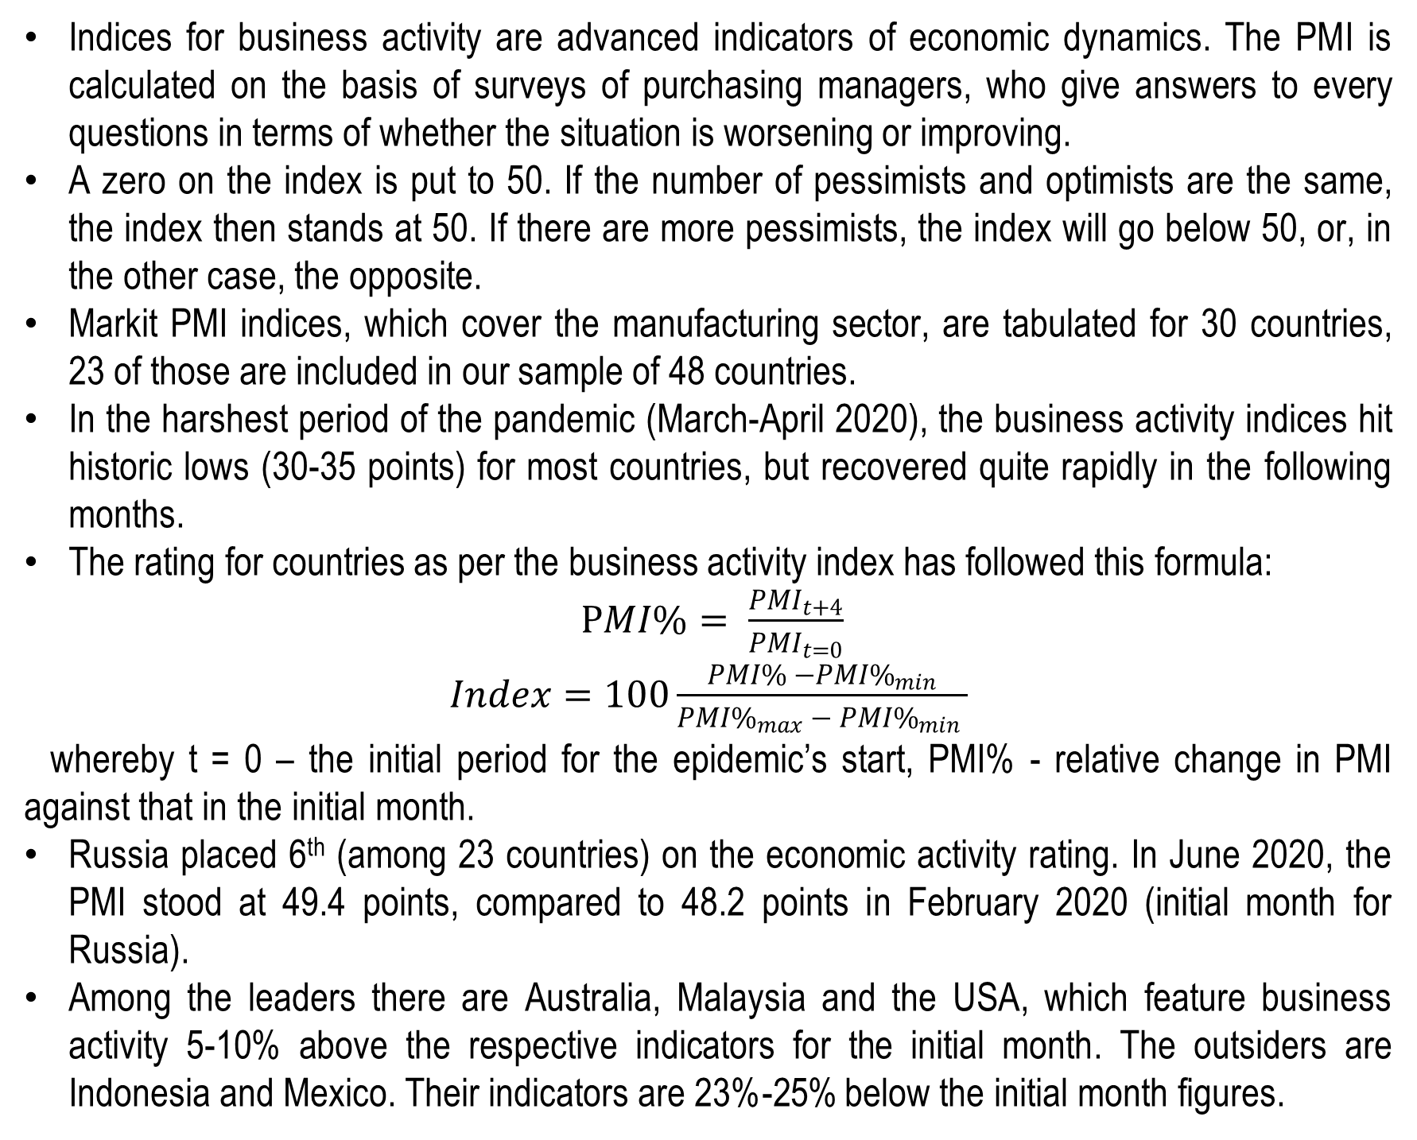
III.2 Changes in Business Activity
Indices for business activity are advanced indicators of economic dynamics. The PMI is calculated on the basis of surveys of purchasing managers, who give answers to every questions in terms of whether the situation is worsening or improving.
A zero on the index is put to 50. If the number of pessimists and optimists are the same, the index then stands at 50. If there are more pessimists, the index will go below 50, or, in the other case, the opposite.
Markit PMI indices, which cover the manufacturing sector, are tabulated for 30 countries, 23 of those are included in our sample of 48 countries.
In the harshest period of the pandemic (March-April 2020), the business activity indices hit historic lows (30-35 points) for most countries, but recovered quite rapidly in the following months.
The rating for countries as per the business activity index has followed this formula:
$PMI\%= \frac{{PMI}_{t+4}}{{PMI}_{t=0}}$
$Index=100\frac{PMI\% −{PMI\%}_{min}}{{PMI\%}_{max} − {PMI\%}_{min} }$
whereby t = 0 – the initial period for the epidemic’s start, PMI% - relative change in PMI against that in the initial month.
Russia placed 6th (among 23 countries) on the economic activity rating. In June 2020, the PMI stood at 49.4 points, compared to 48.2 points in February 2020 (initial month for Russia).
Among the leaders there are Australia, Malaysia and the USA, which feature business activity 5-10% above the respective indicators for the initial month. The outsiders are Indonesia and Mexico. Their indicators are 23%-25% below the initial month figures.
PMI Manufacturing Rating
Business Activity Rating
Source: Eikon, Markit, estimates by HSE University. Note: data for Russia is highlighted in red.

Slide 27
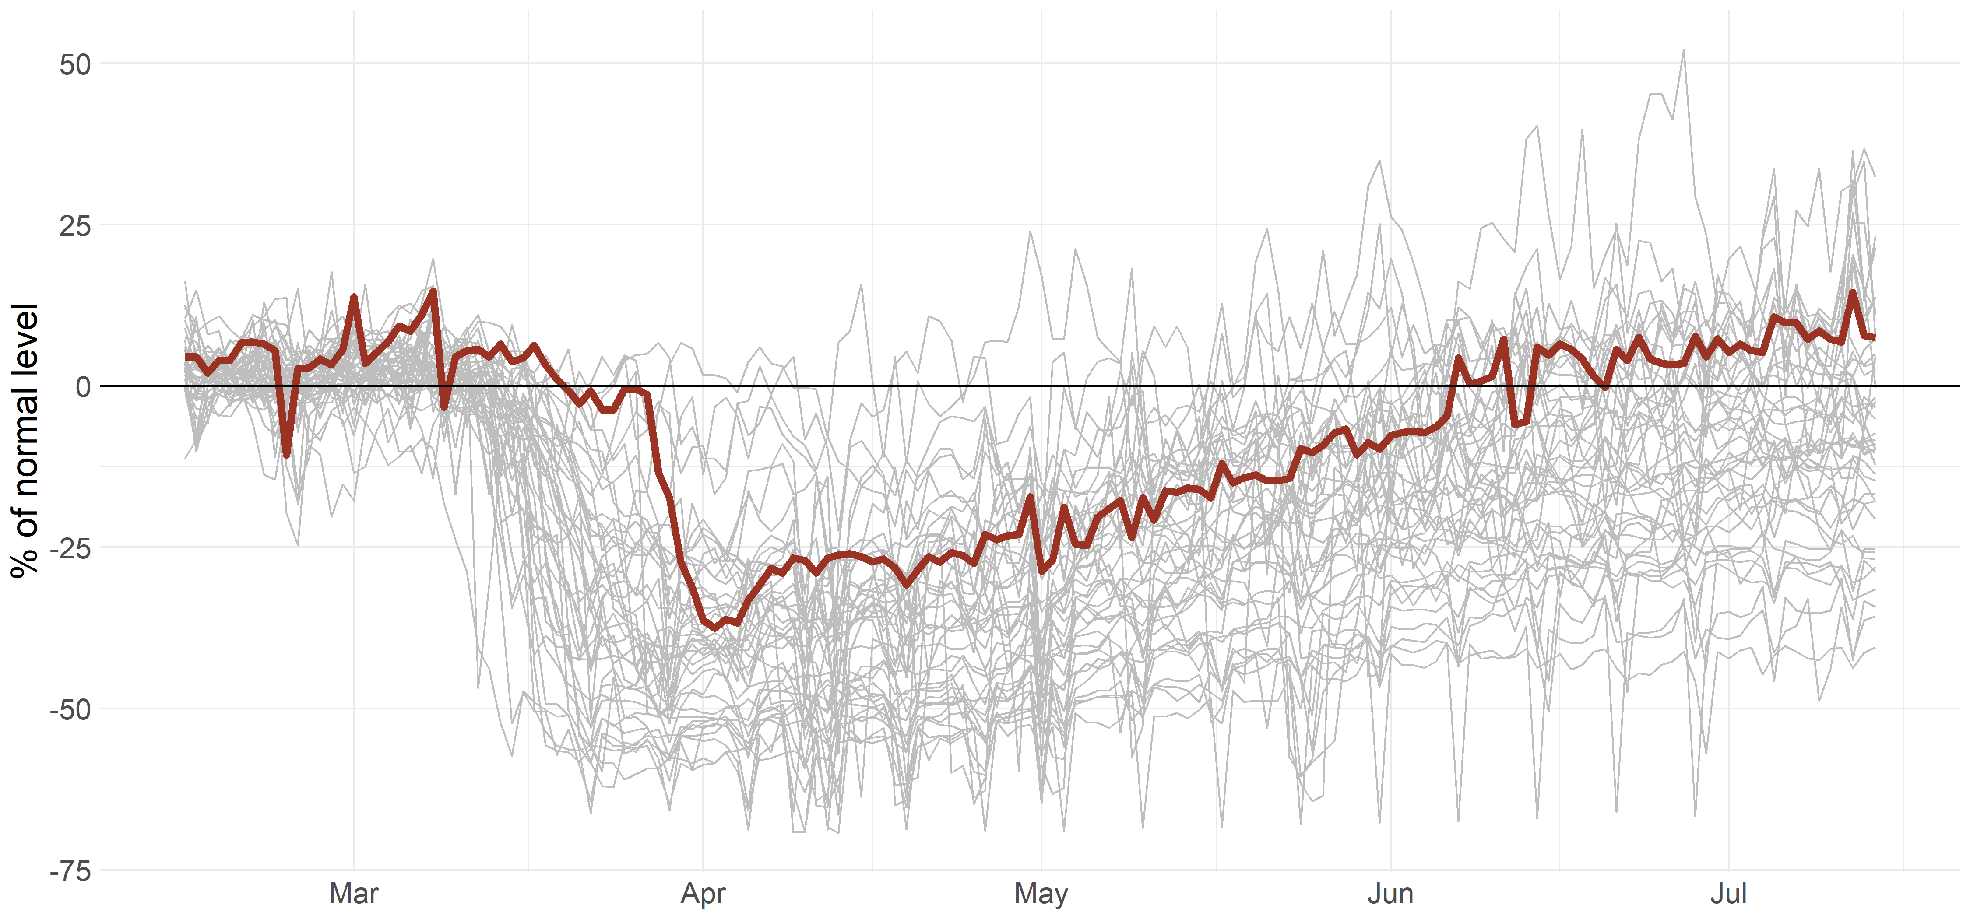
III.3 Changes in Local Mobility
Mobility of the Population
Population Mobility Rating
In order to assess the changes in local mobility, we used Google data for tracking mobile phones .This data shows how stores, offices and parks see change in frequency of visits across geographic regions.
Mobility (movement) is a good proxy indicator of economic activity.
To calculate general mobility, the simple average of 6 individual categories (i.e., places of work, residential areas, food stores, shops, parks, and transport stops) has been calculated.
For China, the mobility indicators (drawn from TomTom service) for the country’s 21 biggest cities (weighted in the number of inhabitants) were used.
The rating was drawn up using data for the first two weeks of July 2020.
The leaders in recovered mobility are: Sweden (100 points), Poland (92), Canada (88), the Czech Republic (88). Outsiders – Chile (0), Argentina (4), Peru (10). Russia placed 8th (81 points).
The mobility of Russian citizens was 7.5% above the normal rate in July 2020.
Source: Google Mobility Report, TomTom Traffic Index, estimates by HSE University.
Note: data for Russia is highlighted in red

Slide 28
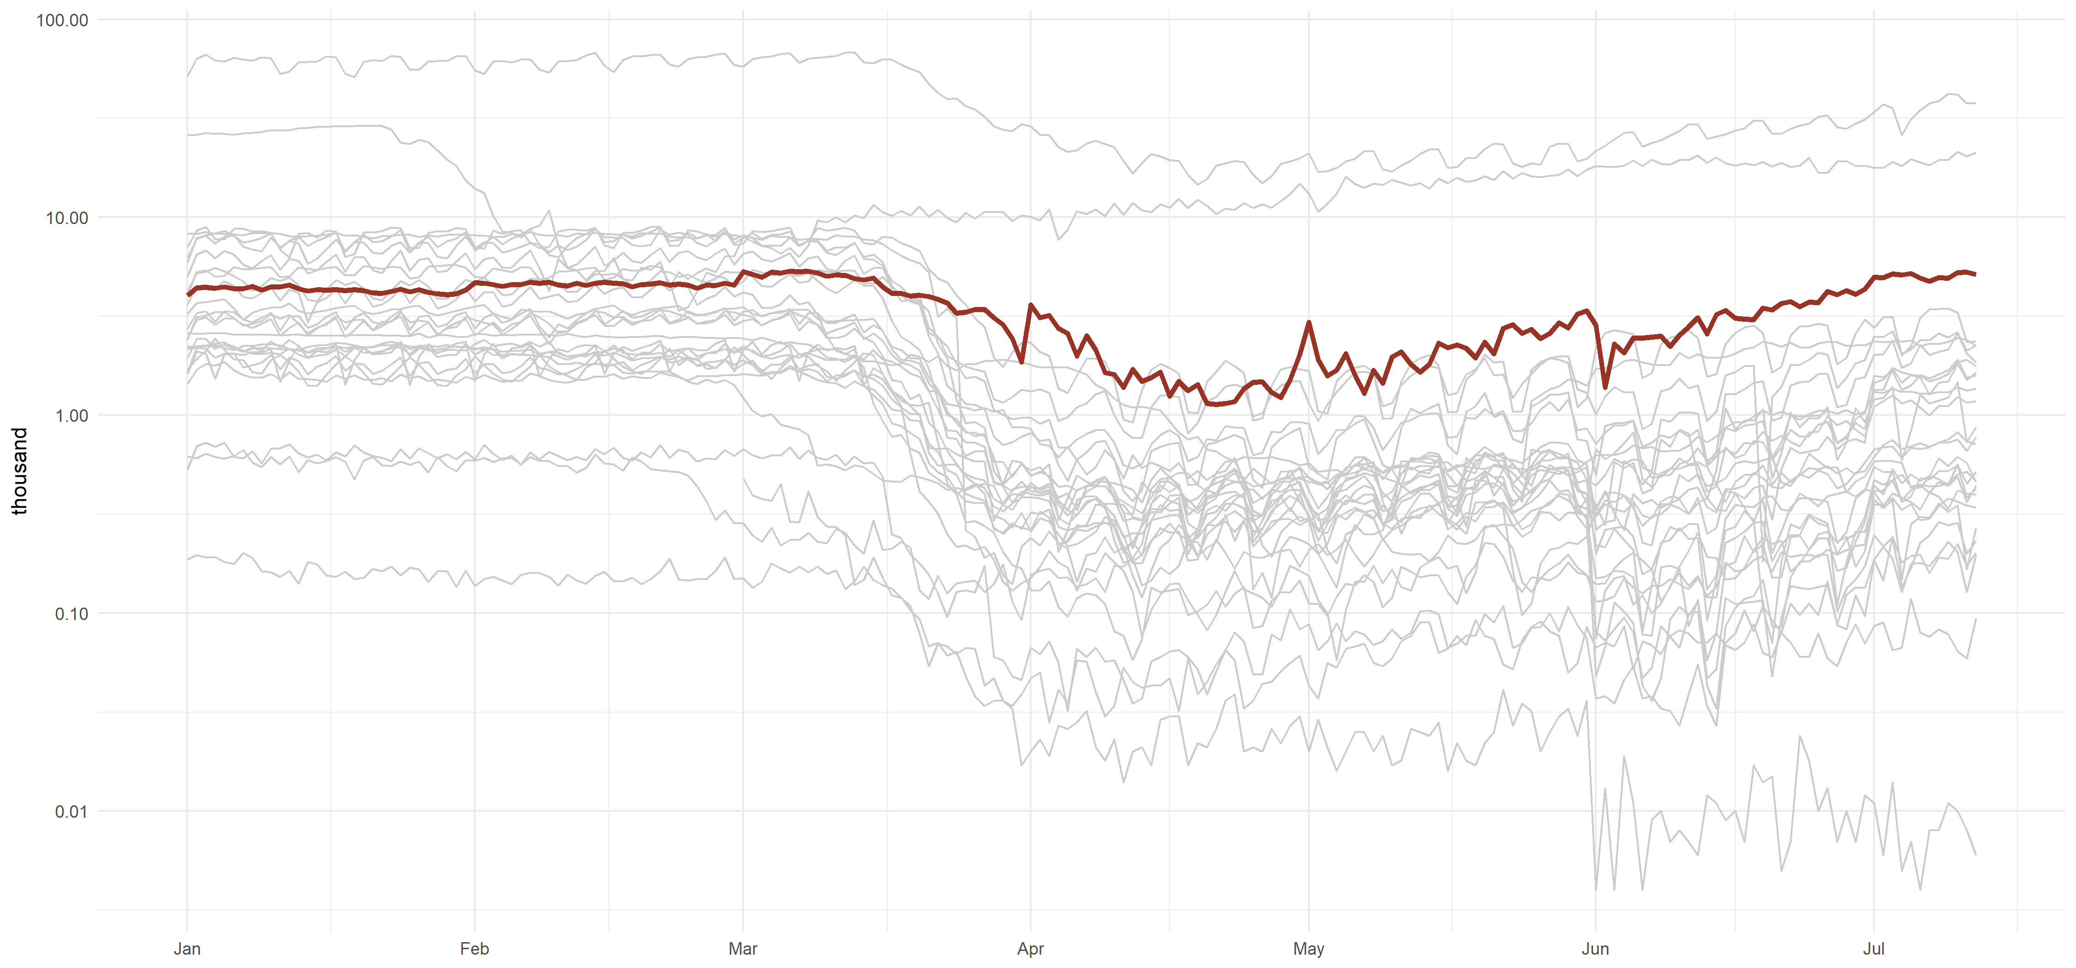
III.4 Changes in Country Connectivity
Air Traffic, Total Number of Take-offs/Landings
Country Connectivity Rating
During the pandemic and lockdown, practically all countries introduced restrictions on international flights, as well as in several instances, restrictions were imposed on internal relocations and movement. The latter limits the transportation connectivity within a given country.
The proxy indicator for country connectivity is the total number of take-offs/landings by air transport. We assess the current total take-offs/landings (for July 10-12), in comparison with the lowest level of the pandemic period. This approach has its limitations, owing to the particular features of transport systems in certain countries and their size. In particular, relatively smaller countries are largely focused on international transport, and this limits the recovery of their air transport under present conditions.
A data source on total take offs/landings is the ICAO (the International Civil Aviation Organization), as well аs the data of national agencies. Unfortunately, a large number of countries do not publish immediate updates on take-offs/landings. Therefore, our current sample for this indicator includes 26 countries.
The leaders for this indicator are China (100 points), Russia (79), Iran (38). Outsiders are Armenia (0), the Czech Republic (3), Sweden (4).
Russia placed second (68 points). The current figure for Russia comes to around 5,200 take-offs/landings a day. The minimal figure during the pandemic period came to 1,200-1,300 take-offs and landings (end of April).
Source: ICAO, national sources. Note: data for Russia is highlighted in red

Slide 29
III.5 Stability of Internet Infrastructure
Speed of Mobile Internet (median value)
Internet Infrastructure Stability Rating
In light of the lockdown, growth in remote working and transfer to the online work, the quality of Internet connection has become crucial in supporting economic activities in many sectors.
As a proxy indicator for stability of infrastructure, data on mobile internet speed has been used, which experiences more fluctuations than broadband internet. During the pandemic, many countries saw a decrease in internet speed owing to surge in infrastructure load.
We assess the maximum decrease in Internet speed during the pandemic – in comparison with the previous maximum speed in 2020.
The leaders in stability of internet infrastructure are Ukraine (100 points), Japan (100), the Netherlands (96), the Czech Republic (88). Outsiders are Ghana (0), Peru (4), Philippines (18).
Russia placed 20th (65 points). Mobile internet speed dropped by 19%, from 13 Mbit/second down to 10.5.
Source: Speed Test, estimates by HSE University. Note: data for Russia is highlighted in red

Slide 30
Authors
Project Heads: Marcel Salikhov, Andrei Zhulin (HSE Institute for Public Administration and Governance)
Natalia Akindinova, HSE Centre of Development
Sergey Kondratyev, Expert at HSE Institute for Public Administration and Governance
Viktor Kurilov, Expert at HSE Institute for Public Administration and Governance
Lilia Ovcharova, HSE Institute for Social Policy
Sergey Shishkin, HSE Centre for Health Policy
Isak Froumin, HSE Institute of Education
Nika Chikvashvili, HSE Faculty of World Economy and International Affairs

